Slide 1
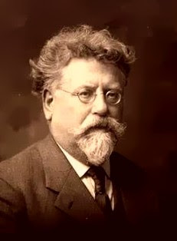
Rudolf Rocker
Born: Mainz, Germany, March 25, 1873
Died: near Crompond, NY, Sept. 19, 1958
Memoiren eines deutschen Anarchisten
Published: edition suhrkamp 1974

Slide 2
Rudolf Rocker was an outstanding speaker, as his contemporaneous, Weimar-era comrades consistently point out. Even his memoirs—nearly 2,200 manuscript pages—are written in an oratorical style. This explains his tendency toward accumulation and repetition, which are less demanding of a listener than a reader. He frequently states something in the first part of a sentence only to restate it in a dependent clause, usually in attenuated form. Here and there we have tacitly ameliorated (verbessert) repetitions such as these, along with Rocker’s Americanisms and his unmistakable stylistic unevenness, although we have of course only done so where these changes preserve the meaning of the source text.
- Editors Magdalena Melnikow and Hans Peter Duerr

Slide 3
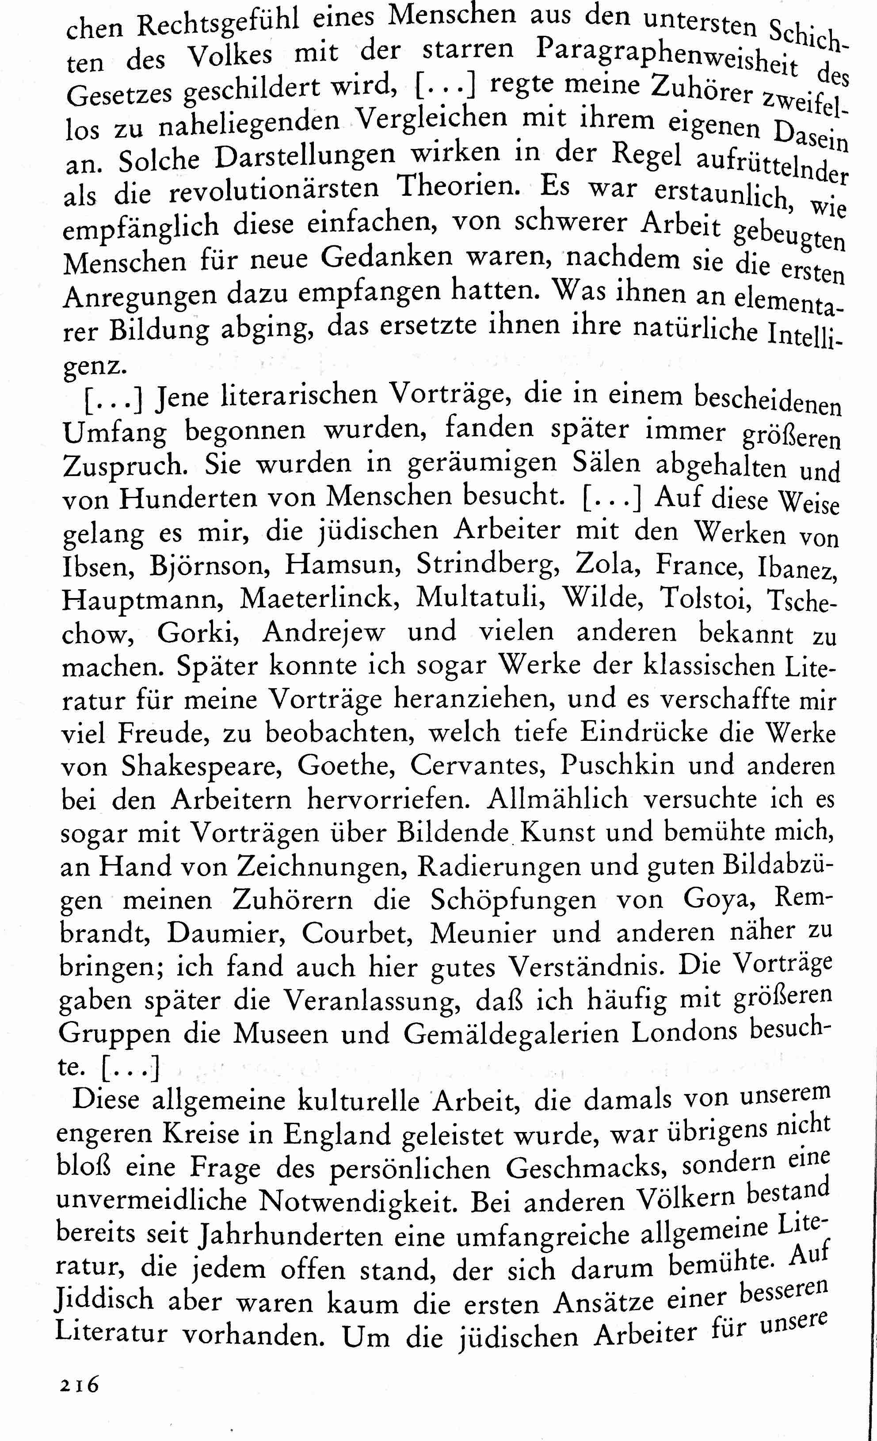
Notes:
Ellipses should be highlighted

Slide 4
[DE]
Als er mit gefesselten Händen und von Gendarmen umringt das Blutgerüst vor sich sah, verhöhnte er gleichsam den Tod, indem er eine Strophe aus dem alten revolutionären Volkslied Le Père Duchène anstimmte. […]
Ein neues Lied, La Ravachole genannt, das nach den Klängen der Carmagnole und des Ça Ira der großen Revolutions gesungen wurde, hörte man damals in allen revolutionären Volksversammlungen.
(106)
[EN]
As he stood before the scaffold, surrounded by gendarmes and with his hands shackled, he scoffed at death, in his way, by singing a verse from the old revolutionary song Le Père Duchène. …
You couldn’t go to a revolutionary assembly after that without hearing a new song called La Ravachole, which was based on the French Revolutionary songs La Carmagnole and Ça ira.

Slide 5
As he stood before the scaffold, surrounded by gendarmes and with his hands shackled, he scoffed at death, in his way, by singing a verse from the old revolutionary song Le Père Duchène.
—I’m sorry to interrupt, but why do you spell it that way?
—Spell it what way?
—Isn’t it D-u-c-h-e-s-n-e? That’s how the newspaper spelled it.
—Okay, fine, you got me on a technicality. French is not my first language and my memory isn’t so 100 per cent, okay? Now, after Ravachol died—
—Do you remember how the song goes?
—What song?
—Le Père Duchesne.
—Remember it? Sure I remember it. What, you want that I should also sing it for you?
—Oh, well, since you mention it, that would be great, thanks!
—Look, I am not a singer. You know this.
—I do know this. Come on, Rudolf. For history! Nobody will hear you anyway—this is strictly a text-based project.
—Damn you. Okay, fine. [ahem]
Né en nonante deux, nom de Dieu,
Mon nom est Père Duchesne …

Slide 6
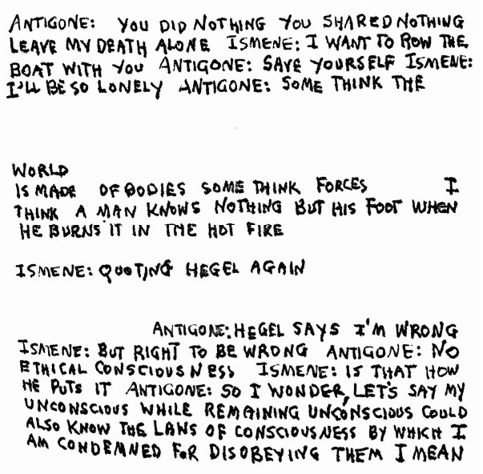

Slide 7
[V]ulgarities which subvert this most adult, unsparingly formal and radiant of masterpieces. Inspired by Hölderlin’s idiosyncratic but incomparable rendition, Heidegger declared the famous choral ode on the nature of man to be the foundational statement in Western civilization. Elizabeth Wyckoff’s version, one among so many, is lucidly attentive. Why Carson’s “customers” instead of “man”? Why this “hilarious cantering” or the all but total omission of the cardinal theme, that of the unhoused wanderer (apolis), outcast from the civic hearth – a theme which crystallizes the Sophoclean reading of the human condition?
George Steiner, “Anne Carson ‘translates’ Antigone”
The Times Literary Supplement, August 1, 2012

Slide 8
Translation should embody an act of thanks to the original. It should celebrate its own dependence on its source. It concentrates scruple and trust, however recreative or anarchic its instincts. It is an informing craft which, sometimes enigmatically, reveals within or adds to the original what was already there – particularly where the text has been translated, imitated, adapted a hundredfold. Anne Carson has often achieved this exigent ideal. But not this time.
Here, the voice-overs by Hegel, Virginia Woolf and Bertolt Brecht are a facile diversion.
George Steiner, “Anne Carson ‘translates’ Antigone”
The Times Literary Supplement, August 1, 2012

Slide 9
This translation is not wrestling with every word or phrase, trying to find felicitous English for the classical Greek, but skipping lines, adding some from contemporary discourse, distilling and dispersing the textual effects of this play for our time. In place of a loyal translation, a different kind of transposition and search for equivalence takes place here. …
Carson does not “rewrite” Antigone. … Antigonick is more transference than translation, a relay of tragedy into a contemporary vernacular that mixes with archaic phrasing.
Judith Butler, “Can’t Stop Screaming”
Public Books, September 5, 2012

Slide 10
To be honest, I don't see any “rewrite” going on. Everything I’ve done in the translation is an attempt to convey a move or shock or darkening that happens in the original text. This doesn’t always mean reproducing the words and sentences of the original in their same order. … It’s true Sophokles doesn’t mention Hegel on the first page of Antigone, but he does refer to the long tradition of A’s catastrophic family in order to remind his Greek audience of the legend and for us, in 2012, the Antigone legend includes Hegel.
Anne Carson, “Anne Carson: Antigonick”
suicidegirls.com, July 29, 2012

